Slide 1
PROFICIENCY TESTING
Prof. Shereen H. Atef
Alsalama Hospital

Slide 2
What is proficiency testing?
Proficiency testing or PT is the testing of unknown samples sent to a laboratory by an approved PT program.
After testing the PT samples in the same manner as its patient specimens, the laboratory reports its sample results back to their PT program.
The program grades the results using quality control grading criteria and sends the laboratory scores reflecting how accurately it performed the testing.
The accreditation organizations routinely monitor their laboratories’ performance.

Slide 3
Why is PT important?
PT is important because it is a tool the laboratory can use to verify the accuracy and reliability of its testing.
Routine reviews of PT reports by the laboratory staff and director will alert them to areas of testing that are not performing as expected and also indicate shifts and trends that, over time, would affect their patient results.

Slide 4
Do I test my PT samples any differently than I test patient specimens?

Slide 5
PT samples must be tested in the same manner you test patient specimens. This means testing the PT samples the same number of times as patient specimens, at the same time as patient specimens, by the same personnel that routinely test the patient specimens, and using the same test system that is routinely used for the patient specimens.
PT samples should be rotated among the testing personnel in your laboratory.

Slide 6
Please note that some PT sample preparation may be necessary before testing. In other words, after preparation, PT samples must be treated in the same manner as patient specimens. However, NEVER send PT samples out of your laboratory for any reason, even if you routinely send out patient specimens for additional or confirmatory testing.

Slide 7
How long do I have to test and report the PT samples?
The instructions that accompany the PT samples will state the exact date by which you must return your PT results to the program.
It is very important to return them on time. A late submission will result in a score of zero for the testing event

Slide 8


Test materials in EQA
Body fluids, e.g. whole
blood, serum, plasma, urine
– Sub-samples from pool
– Sub-sample from single-donor
- Smears
- Digital images
- Video sequences

Slide 9

Test material requirements
Stability
– Normally not as long as for reference materials
Homogeneity
– Same as for reference materials (“fit for the intended
use”)
Viability (should stay alive)
”Commutability” (mimic patient samples)
Additives (e.g. stabilisers) and manipulations (e.g.
freeze drying/reconstitution) can affect matrix
& cause interferences

Slide 10





Communication between organiser and participants

Slide 11
May I discuss my PT results with another laboratory?
NEVER discuss your PT results with another laboratory and NEVER enter into discussion with another laboratory about their PT results before the PT event cut-off date. This activity may cause you to lose your certificate

Slide 12
May I send my PT samples to another laboratory to see if they get the same results as I do?

Slide 13
NEVER send your PT samples to another laboratory even if you send your patient specimens to another laboratory for confirmation or identification testing.
Sending PT samples to another laboratory for testing is considered PT referral and will cause serious actions to be taken against the laboratory.

Slide 14
What do I do if I receive PT samples from another laboratory for testing?
As soon as you identify them as PT samples, notify your inspecting agency (your accreditation organization if your laboratory is accredited or your State agency inspectors) that you have received PT samples from another laboratory, tell them the name of the other laboratory and the test(s) requested, but DO NOT TEST the samples.

Slide 15
Do I need to keep records of my PT testing?
Yes, you must keep a copy of all your records, such as
the step by step PT sample preparation and handling,
all the steps taken in the testing of the sample, a copy of the PT program results form used to record and submit your PT results
a print screen if results are entered electronically,
and the PT program’s evaluation of your laboratory’s performance, etc. These copies must be maintained for a minimum of two years from the date of the PT event. If any corrective actions are taken as a result of an unsatisfactory or unacceptable score, maintain records of these actions for two years also.

Slide 16
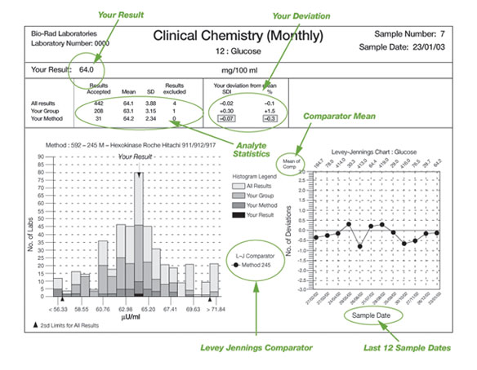
Performance evaluation & result reports 12 reports each cycle (provided bi-weekly or monthly) Easy-to-read graphical format Summary of sample results for convenient overview Comprehensive data analysis by individual analyte

Slide 17
What steps should I take after I have received my PT results from the PT program?

Slide 18
Always review your results with your co-workers and your director. Your PT program will include an evaluation for each of the five challenges for each test or analyte in the PT event and will detail the performance of each test system used by the laboratories enrolled with their program.
This should be done for all PT results, even those with passing scores. If you receive an 80% score, you should investigate why one of the five samples was outside the acceptable range of results. Document your investigation and what you did to correct the problem that caused the challenge failure.

Slide 19
What must I do if I do not get a passing score when the PT program grades my results?

Slide 20
Corrective Action
Re-review the results that were submitted to the PT program for scoring for any obvious errors (this should have been done prior to submitting your results to the program).
Clerical or transcription errors are considered incorrect results. The consultant of laboratory as well as the personnel who performed the testing of the PT samples should compare their PT results with the inter-laboratory comparison evaluations provided by the PT program. You must take remedial actions, i.e., determine the cause of the error or errors, correct it (them), and document your actions.
Continually monitor the test system performance, review the results of the quality control materials, and discuss with your colleague to be certain the test system is operating properly and producing accurate results.
Your director may want to review the results of the patients tested during the unsatisfactory or unacceptable testing event.
Depending upon the test system’s performance and your director’s decision, you may need to contact the manufacturer of the test system for assistance.

Slide 21

Thank you!
“Perhaps we may never
know where we are in the
analytical universe in an
absolute sense, but certainly
we ought to know where we
are in relation to each other”
William Horwitz
Chemistry in Australia, 1982

